Slide 1
Chapter 14 Stacks and Queues

Slide 2
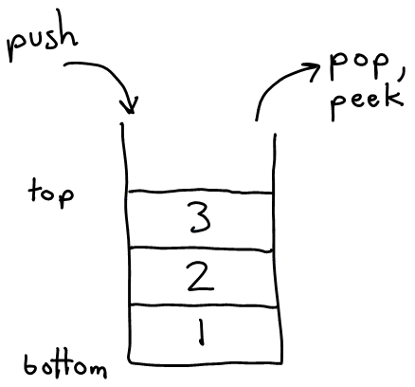
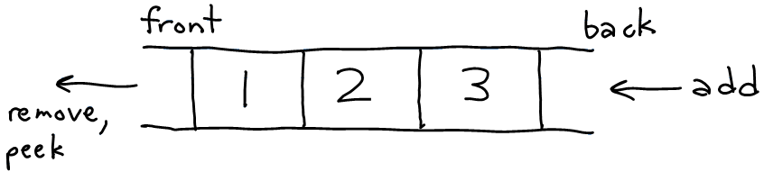
Stacks and queues
Sometimes it is good to have a collection that is less powerful, but is optimized to perform certain operations very quickly.
Stacks and queues do few things, but they do them efficiently.
stack: Retrieves elements in the reverse of the order they were added.
queue: Retrieves elements in the same order they were added.
queue
stack

Slide 3
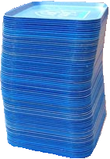
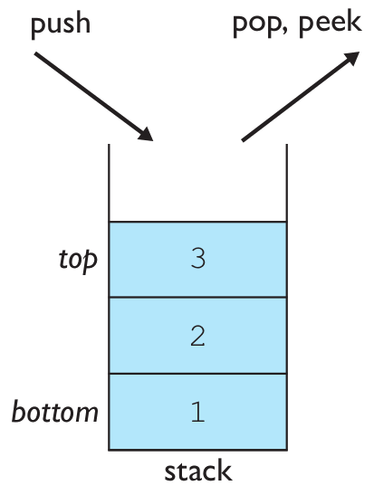
Stacks
stack: A collection based on the principle of adding elements and retrieving them in the opposite order.
Last-In, First-Out ("LIFO")
The elements are stored in order of insertion, but we do not think of them as having
indexes.
The client can only add/remove/examine the last element added (the "top").
basic stack operations:
push: Add an element to the top.
pop: Remove the top element.
peek: Examine the top element.
Notes:
analogy: trays of food at the sizzler

Slide 4
Stacks
A stack can be viewed as a special type of list, where the elements are accessed, inserted, and deleted only from the end, called the top, of the stack.

Slide 5
Stacks in computer science
Programming languages and compilers:
method calls are placed onto a stack (call=push, return=pop)
compilers use stacks to evaluate expressions
Matching up related pairs of things:
find out whether a string is a palindrome
examine a file to see if its braces { } and other operators match
convert "infix" expressions to "postfix" or "prefix"
Sophisticated algorithms:
many programs use an "undo stack" of previous operations
method3 | return var local vars parameters
method2 | return var local vars parameters
method1 | return var local vars parameters

Slide 6
Class Stack
Stack<Integer> s = new Stack<Integer>();
s.push(42);
s.push(-3);
s.push(17); // bottom [42, -3, 17] top
System.out.println(s.pop()); // 17
Stack has other methods, but we do not recommend you to use them.
Stack<E>() | constructs a new stack with elements of type E
push(value) | places given value on top of stack
pop() | removes top value from stack and returns it; throws EmptyStackException if stack is empty
peek() | returns top value from stack without removing it; throws EmptyStackException if stack is empty
size() | returns number of elements in stack
isEmpty() | returns true if stack has no elements

Slide 7
Stack limitations/idioms
Remember: You cannot loop over a stack in the usual way.
Stack<Integer> s = new Stack<Integer>();
...
for (int i = 0; i < s.size(); i++) {
do something with s.get(i);
}
Instead, you must pull contents out of the stack to view them.
common idiom: Removing each element until the stack is empty.
while (!s.isEmpty()) {
do something with s.pop();
}

Slide 8
Exercise
import java.util.Stack;
public class StackExample {
public static void main(String[] args) {
String[] data = {"to", "be", "or", "not", "to", "be"};
Stack<String> s = new Stack<>();
for (String str : data) {
s.push(str);
}
System.out.println("stack = " + s);
System.out.println("size = " + s.size());
System.out.println("peek = " + s.peek());
while (!s.isEmpty()) {
System.out.print(s.pop() + " ");
}
System.out.println();
}
}
stack = [to, be, or, not, to, be]
size = 6
peek = be
be to not or be to
Notes:
notion of looping over a collection while modifying it
notion of not destroying a stack while examining it (write 1st version that destroys stack, 2nd version puts it back)

Slide 9
What happened to my stack?
To write a method max that accepts a Stack of integers and returns the largest integer in the stack.
The following solution is seemingly correct:
// Precondition: s.size() > 0
public static int max(Stack<Integer> s) {
int maxValue = s.pop();
while (!s.isEmpty()) {
int next = s.pop();
maxValue = Math.max(maxValue, next);
}
return maxValue;
}
The algorithm is correct, but what is wrong with the code?

Slide 10
What happened to my stack?
The code destroys the stack in figuring out its answer.
To fix this, you must save and restore the stack's contents:
public static int max(Stack<Integer> s) {
Stack<Integer> backup = new Stack<Integer>();
int maxValue = s.pop();
backup.push(maxValue);
while (!s.isEmpty()) {
int next = s.pop();
backup.push(next);
maxValue = Math.max(maxValue, next);
}
while (!backup.isEmpty()) {
s.push(backup.pop());
}
return maxValue;
}

Slide 11
Exercise
import java.util.Stack;
public class StackMax {
public static void main(String[] args) {
Stack<Integer> s = new Stack<>();
Integer[] data = {5, 8, 16, 7, 9};
for (Integer num : data) {
s.push(num);
}
System.out.println("Original stack = " + s);
System.out.println("The max number in the Stack is : " + max(s));
System.out.println("stack = " + s); }
public static int max(Stack<Integer> s) {
Stack<Integer> backup = new Stack<>();
int maxValue = s.pop();
backup.push(maxValue);
while (!s.isEmpty()) {
int next = s.pop();
backup.push(next);
maxValue = Math.max(maxValue, next);
}
while (!backup.isEmpty()) {
s.push(backup.pop());
}
return maxValue;
}
}
Original stack = [5, 8, 16, 7, 9]
The max number in the Stack is : 16
stack = [5, 8, 16, 7, 9]
Notes:
notion of looping over a collection while modifying it
notion of not destroying a stack while examining it (write 1st version that destroys stack, 2nd version puts it back)

Slide 12
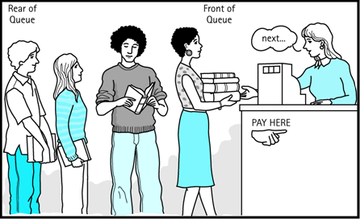
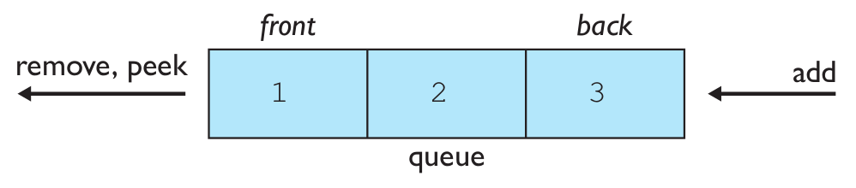
Queues
queue: Retrieves elements in the order they were added.
First-In, First-Out ("FIFO")
Elements are stored in order of insertion but don't have indexes.
Client can only add to the end
of the queue, and can only
examine/remove the front of the queue.
basic queue operations:
add (enqueue): Add an element to the back.
remove (dequeue): Remove the front element.
peek: Examine the front element.
Notes:
analogy: trays of food at the sizzler

Slide 13
Queues
A queue represents a waiting list.
A queue can be viewed as a special type of list, where the elements are inserted into the end (tail) of the queue, and are accessed and deleted from the beginning (head) of the queue.

Slide 14
Queues in computer science
Operating systems:
queue of print jobs to send to the printer
queue of programs / processes to be run
queue of network data packets to send
Programming:
modeling a line of customers or clients
storing a queue of computations to be performed in order
Real world examples:
people on an escalator or waiting in a line
cars at a gas station (or on an assembly line)

Slide 15
Programming with Queues
Queue<Integer> q = new LinkedList<Integer>();
q.add(42);
q.add(-3);
q.add(17); // front [42, -3, 17] back
System.out.println(q.remove()); // 42
IMPORTANT: When constructing a queue you must use a new LinkedList object instead of a new Queue object.
This has to do with a topic we'll discuss later called interfaces.
add(value) | places given value at back of queue
remove() | removes value from front of queue and returns it; throws a NoSuchElementException if queue is empty
peek() | returns front value from queue without removing it; returns null if queue is empty
size() | returns number of elements in queue
isEmpty() | returns true if queue has no elements

Slide 16
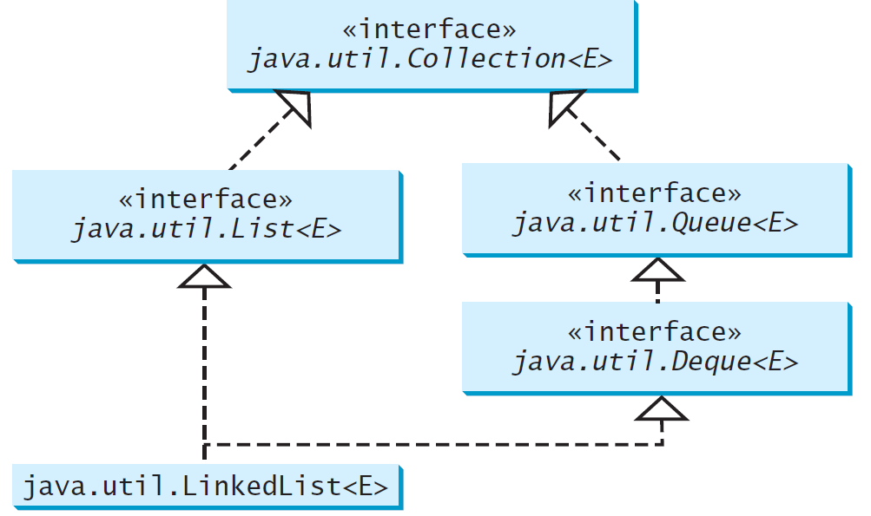
Using LinkedList for Queue
The LinkedList class implemented the Deque interface, which extends the Queue interface.
Use LinkedList to create a queue.
LinkedList is ideal for queue operation because it is efficient for inserting and removing elements from both ends of a list

Slide 17
Queue idioms
As with stacks, must pull contents out of queue to view them.
while (!q.isEmpty()) {
do something with q.remove();
}
another idiom: Examining each element exactly once.
int size = q.size();
for (int i = 0; i < size; i++) {
do something with q.remove();
(including possibly re-adding it to the queue)
}
Why do we need the size variable?
Notes:
examining each element once is like

Slide 18
Exercise
import java.util.*;
public class QueueExample {
public static void main(String[] args) {
String[] data = {"to", "be", "or", "not", "to", "be"};
Queue<String> q = new LinkedList<String>();
for (String str : data) {
q.add(str);
}
System.out.println("queue = " + q);
System.out.println("size = " + q.size());
System.out.println("peek = " + q.peek());
while (!q.isEmpty()) {
System.out.print(q.remove() + " ");
}
System.out.println();
}
}
queue = [to, be, or, not, to, be]
size = 6
peek = to
to be or not to be
Notes:
notion of looping over a collection while modifying it
notion of not destroying a stack while examining it (write 1st version that destroys stack, 2nd version puts it back)

Slide 19
Mixing stacks and queues
Mix stacks and queues to achieve certain effects.
Example: Reverse the order of the elements of a queue.
Queue<Integer> q = new LinkedList<Integer>();
q.add(1);
q.add(2);
q.add(3); // [1, 2, 3]
Stack<Integer> s = new Stack<Integer>();
while (!q.isEmpty()) { // Q -> S
s.push(q.remove()); //[1 , 2, 3]
}
while (!s.isEmpty()) { // S -> Q
q.add(s.pop()); //[3, 2, 1]
}
System.out.println(q); // [3, 2, 1]

Slide 20
Exercise
import java.util.Queue; import java.util.Stack; import java.util.LinkedList;
public class QueueToStack {
public static void main(String[] args) {
Queue<Integer> q = new LinkedList<>();
q.add(1);
q.add(2);
q.add(3);
System.out.print("Queue = " + q); // [1, 2, 3]
System.out.println();
Stack<Integer> s = new Stack<>();
while (!q.isEmpty()) { // Q -> S
s.push(q.remove());
}
System.out.print("Stack = " + s); //[1 , 2, 3]
System.out.println();
while (!s.isEmpty()) { // S -> Q
q.add(s.pop());
}
System.out.print("Queue = " + q); //[3, 2, 1]
}
}
Queue = [1, 2, 3]
Stack = [1, 2, 3]
Queue = [3, 2, 1]
Notes:
notion of looping over a collection while modifying it
notion of not destroying a stack while examining it (write 1st version that destroys stack, 2nd version puts it back)

Slide 21
Sum of a Queue Exercises
public static int sum(Queue<Integer> q){
int sum=0;
while(!q.isEmpty()){
int n = q.remove();
sum += n;
}
return sum;
}
The code destroys the queue in figuring out its answer.
To fix this, you must save and restore the queue's contents

Slide 22
Sum of a Queue -auxiliary queue
public static int sum(Queue<Integer> q){
int sum=0;
Queue<Integer> temp = new LinkedList<>();
while(!q.isEmpty()){
int n = q.remove();
sum += n;
temp.add(n);
}
while (!temp.isEmpty()){
q.add(temp.remove());
}
return sum;
}
Use a second queue as auxiliary storage
q [1, 2, 3, 4]
temp[]
temp[1, 2, 3, 4]
q []
q [1, 2, 3, 4]

Slide 23
Sum of a Queue –use the original queue
public static int sum(Queue<Integer> q){
int sum=0;
for (int i=0; i<q.size(); i++){
int n = q.remove();
sum += n;
q.add(n);
}
return sum;
}
Re-add elements to the same queue
q [1, 2, 3]
i=0
//remove first (1)from the queue
q [2, 3]
//add 1 back to
the queue
q [2, 3, 1]
q [ 2, 3, 1]
i=1
//remove first (2)from the queue
q [3, 1]
//add 2 back to the queue
q [3, 1, 2]
q [3, 1, 2]
i=2
//remove first (3)from the queue
q [1, 2]
//add 3 back to the queue
q [1, 2, 3]

Slide 24
Remove values from a Queue
public static void removeAll(Queue<Integer> q, int value){
int oldSize = q.size(); //4
for (int i=0; i<oldSize; i++){ //don’t use i < q.size()
int n = q.remove();
if (n != value){
q.add(n);
}
}
}
removeAll(q,2);
q [ 2, 3, 2, 1]
i=1
//remove first (2)from the queue
q [3, 2, 1]
//do not add 2 back to the queue
q [3, 2, 1]
q [3, 2, 1]
i=2
//remove first (3)from the queue
q [2, 1]
//add 3 back to the queue
q [2, 1, 3]
q [1, 2, 3, 2]
i=0
//remove first (1)from the queue
q [2, 3 ,2]
//add 1 back to
the queue
q [2, 3, 2, 1]
q [2, 1, 3]
i=3
//remove first (2)from the queue
q [1, 3]
//do not add 2 back to the queue
q [1, 3]

Slide 25
Stack/queue exercise
A postfix expression is a mathematical expression but with the operators written after the operands rather than before.
1 + 1 becomes 1 1 +
1 + 2 * 3 + 4 becomes 1 2 3 * + 4 +
supported by many kinds of fancy calculators
never need to use parentheses
never need to use an = character to evaluate on a calculator
Write a method postfixEvaluate that accepts a postfix expression string, evaluates it, and returns the result.
All operands are integers; legal operators are + , -, *, and /
postFixEvaluate("5 2 4 * + 7 -") returns 6

Slide 26
Postfix algorithm
The algorithm: Use a stack
When you see an operand, push it onto the stack.
When you see an operator:
pop the last two operands off of the stack.
apply the operator to them.
push the result onto the stack.
When you're done, the one remaining stack element is the result.
"5 2 4 * + 7 -"
5 + 2 * 4 - 7
5
5
2
2
5
4
4
2
5
*
8
5
+
13
7
7
13
-
6

Slide 27
Exercise solution
// Evaluates the given expression and returns its result.
// Precondition: string represents a legal postfix expression
public static int postfixEvaluate(String expression) {
Stack<Integer> s = new Stack<Integer>();
Scanner input = new Scanner(expression);
while (input.hasNext()) {
if (input.hasNextInt()) { // an operand (integer)
s.push(input.nextInt());
} else { // an operator
String operator = input.next();
int operand2 = s.pop();
int operand1 = s.pop();
if (operator.equals("+")) {
s.push(operand1 + operand2);
} else if (operator.equals("-")) {
s.push(operand1 - operand2);
} else if (operator.equals("*")) {
s.push(operand1 * operand2);
} else {
s.push(operand1 / operand2);
}
}
}
return s.pop();
}
"5 2 4 * + 7 -"

Slide 28
Exercise
import java.util.Scanner;
import java.util.Stack;
public class Evaluation {
public static void main(String[] args) {
String s = "5 2 4 * + 7 -";
System.out.println("The result of the calculation is " + postfixEvaluate(s));
}
Notes:
notion of looping over a collection while modifying it
notion of not destroying a stack while examining it (write 1st version that destroys stack, 2nd version puts it back)

Slide 29
public static int postfixEvaluate(String expression) {
Stack<Integer> s = new Stack<>();
Scanner input = new Scanner(expression);
while (input.hasNext()) {
if (input.hasNextInt()) { // an operand (integer)
s.push(input.nextInt());
} else { // an operator
String operator = input.next();
int operand2 = s.pop();
int operand1 = s.pop();
if (operator.equals("+")) {
s.push(operand1 + operand2);
} else if (operator.equals("-")) {
s.push(operand1 - operand2);
} else if (operator.equals("*")) {
s.push(operand1 * operand2);
} else {
s.push(operand1 / operand2);
}
}
}
return s.pop();
}
}
Notes:
notion of looping over a collection while modifying it
notion of not destroying a stack while examining it (write 1st version that destroys stack, 2nd version puts it back)

